Slide 1

Uipath
Guru S. Anand
gurusanand@gmail.com

Slide 2
Good Luck and Best Wishes!
If you work on really difficult things you are better off because you are not having any competition. Be proud as others are not working on that difficult problem.
Even if you fail, you’ll end up doing something great in the process.
In this world it is important to be well rounded, try different things, take risk and encourage other colleagues, division to innovate.
I wish the team - Good Luck for the journey!

Slide 3
Applications
Desktop Applications
Client Server Applications
Web Applications
Mobile Applications

Slide 4
Applications
Desktop Applications
Client Server Applications
Web Applications
Mobile Applications

Slide 5
Variables
We need a place to store some information . To store the data, so that the data could be used for the entire program.

Slide 6
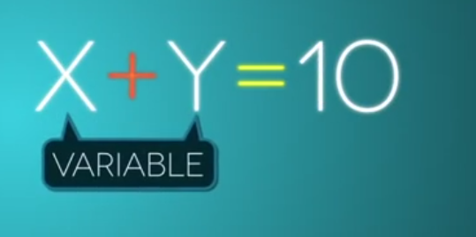
Questions?
A variable is nothing but a name given to a storage area that our programs can manipulate.

Slide 7
Questions?
Function
Sub
Operator
Get
Set
RaiseError
The constants refer to fixed values that the program may not alter during its execution. These fixed values are also called literals.

Slide 8
Questions?
The modifiers are keywords added with any programming element to give some especial emphasis on how the programming element will behave or will be accessed in the program.
For example, the access modifiers: Public, Private, Protected, Friend, Protected Friend, etc., indicate the access level of a programming element like a variable, constant, enumeration or a class.
Private | Specifies that one or more declared programming elements are accessible only from within their declaration context, including from within any contained types.
Public | Specifies that one or more declared programming elements have no access restrictions.

Slide 9
Properties and Methods
Properties and Methods

Slide 10
Date
The Date data type contains date values, time values, or date and time values. The default value of Date is 0:00:00 (midnight) on January 1, 0001. The equivalent .NET data type is System.DateTime.
The DateTime structure represents an instant in time, typically expressed as a date and time of day

Slide 11
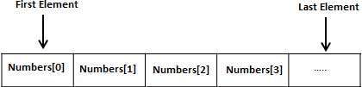
Array
An array stores a fixed-size sequential collection of elements of the same type. An array is used to store a collection of data, but it is often more useful to think of an array as a collection of variables of the same type.
All arrays consist of contiguous memory locations. The lowest address corresponds to the first element and the highest address to the last element.

Slide 12
Array
A procedure is a group of statements that together perform a task when called. After the procedure is executed, the control returns to the statement calling the procedure.

Slide 13
Questions?
Object - Objects have states and behaviors. Example: A dog has states - color, name, breed as well as behaviors - wagging, barking, eating, etc. An object is an instance of a class.
Class - A class can be defined as a template/blueprint that describes the behaviors/states that objects of its type support.
Methods - A method is basically a behavior. A class can contain many methods. It is in methods where the logics are written, data is manipulated and all the actions are executed.

Slide 14
Questions?
Data Type | Storage Allocation | Value Range
Boolean | Depends on implementing platform | True or False
Byte | 1 byte | 0 through 255 (unsigned)
Char | 2 bytes | 0 through 65535 (unsigned)
Date | 8 bytes | 0:00:00 (midnight) on January 1, 0001 through 11:59:59 PM on December 31, 9999
Decimal | 16 bytes | 0 through +/-79,228,162,514,264,337,593,543,950,335 (+/-7.9...E+28) with no decimal point; 0 through +/-7.9228162514264337593543950335 with 28 places to the right of the decimal
Double | 8 bytes | -1.79769313486231570E+308 through -4.94065645841246544E-324, for negative values
Integer | 4 bytes | -2,147,483,648 through 2,147,483,647 (signed)
Long | 8 bytes | -9,223,372,036,854,775,808 through 9,223,372,036,854,775,807(signed)
Object | 4 bytes on 32-bit platform | Any type can be stored in a variable of type Object
 | 8 bytes on 64-bit platform
SByte | 1 byte | -128 through 127 (signed)
Short | 2 bytes | -32,768 through 32,767 (signed)
Single | 4 bytes | -3.4028235E+38 through -1.401298E-45 for negative values;
 |  | 1.401298E-45 through 3.4028235E+38 for positive values
String | Depends on implementing platform | 0 to approximately 2 billion Unicode characters
UInteger | 4 bytes | 0 through 4,294,967,295 (unsigned)
ULong | 8 bytes | 0 through 18,446,744,073,709,551,615 (unsigned)
User-Defined | Depends on implementing platform | Each member of the structure has a range determined by its data type and independent of the ranges of the other members
UShort | 2 bytes | 0 through 65,535 (unsigned)

Slide 15
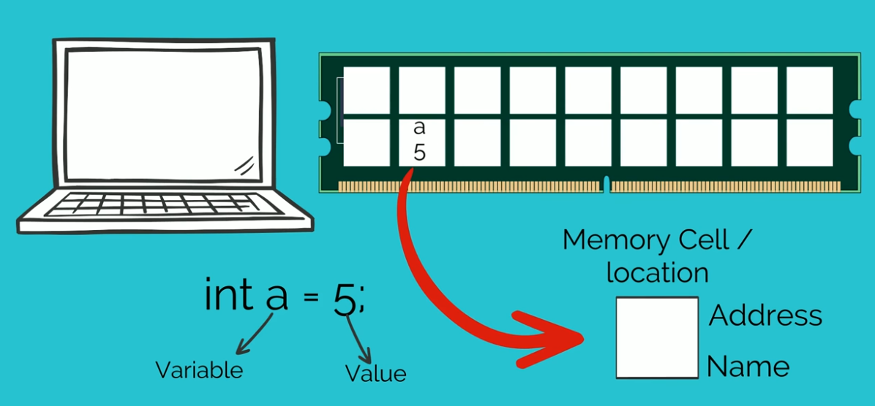
Questions?

Slide 16
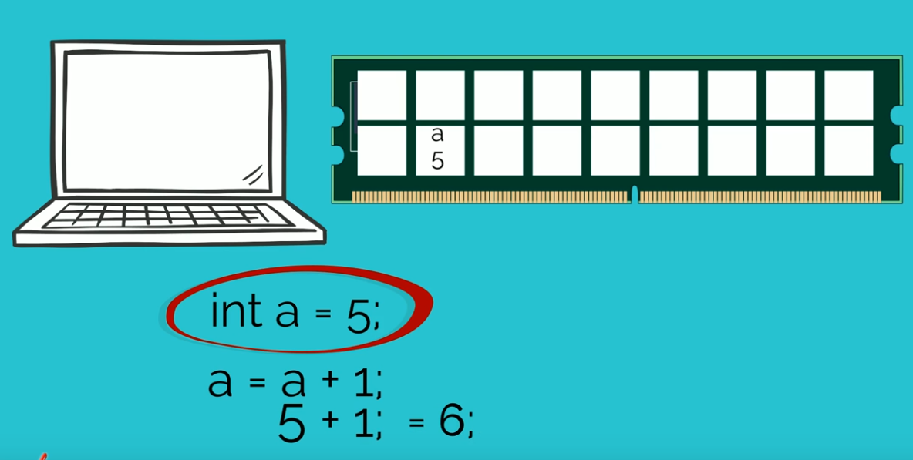
Questions?

Slide 17
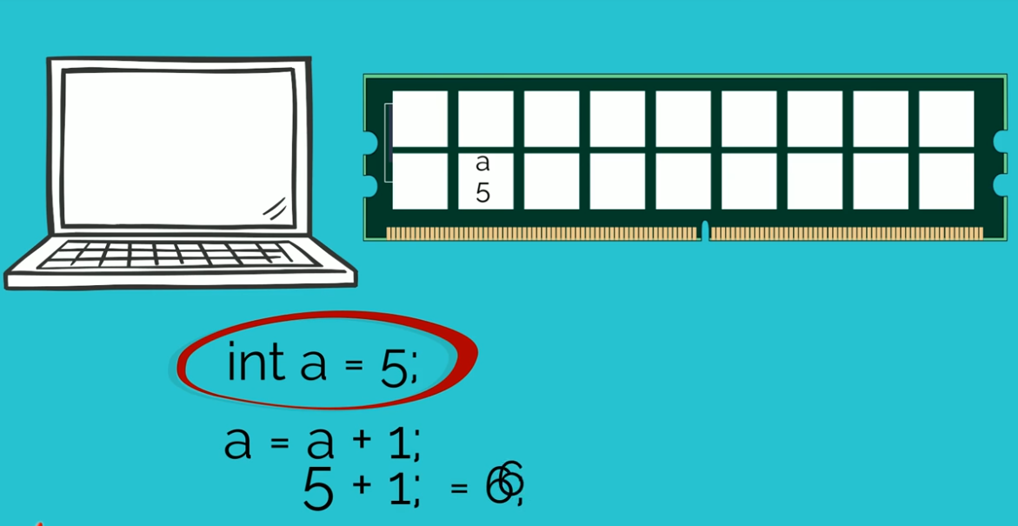
Questions?

Slide 18
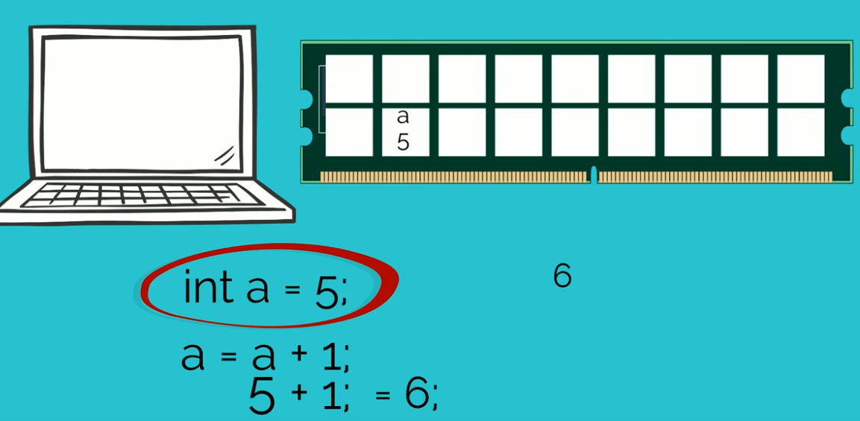
Questions?

Slide 19
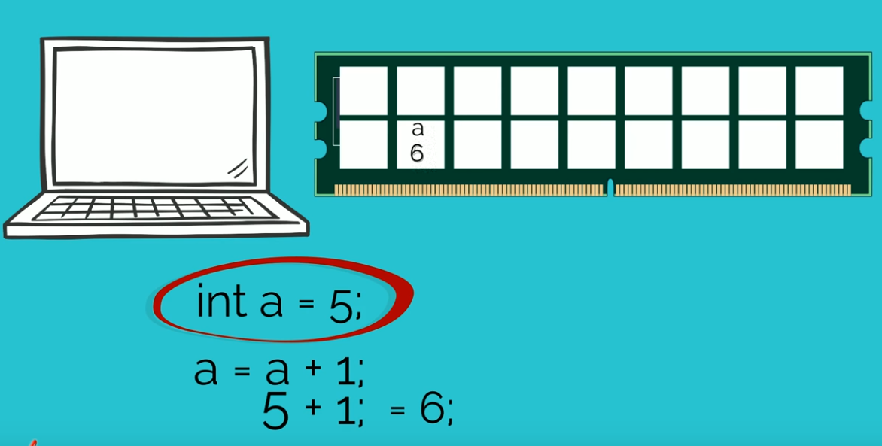
Questions?

Slide 20
Questions?

Slide 21
Thank You

Slide 22
Questions?

